Slide 1
Computer Science & ICT subject development day 1
Welcome back!

Slide 2
Today we will
reflect and share experiences of the first month of teaching
reflect on the factors involved in classroom management and identify strategies for addressing common issues in the classroom
recap key learning theories and identify in your own teaching (lesson plans)
introduce requirements of Written Assignment 2 (SWA2)
engage critically with current research in computer science education

Slide 3
Session 1
To reflect and share experiences of the first month of teaching
To reflect on the factors involved in behaviour management and identify strategies for addressing common issues in the classroom (link with teacher standard S7 – behaviour management)

Slide 4
How’s it going?
Individually
identify a couple of successes
identify some of the challenges / worries that you are experiencing (refer to your journal)
In pairs
discuss with your partner
group the challenges into themes
identify common challenges that you are both facing
Be ready to feed back to the group

Slide 5
Finding solutions
Pick one or two challenges that you are facing
‘problematize’ the challenge
Explore possible causes / triggers for each ‘problem’
Identify a range of potential solutions
Decide which solution(s) are likely to be most effective
Stretch yourselves
For each solution you choose, identify the resources necessary to make this happen

Slide 6
Classroom* management
Participants reflect on the factors involved in promoting a positive climate for learning
including rules and routines
including behaviour management, B4L techniques & experiences of this so far
Participants identify techniques for improving classroom management
*But note that management of the classroom goes beyond managing behaviour

Slide 7
Behaviour management
A set of skills that can be improved through practice, training, observation & experience
Behaviour is learned and can change
although it may take explicit teaching, time and persistence to do so
particularly at the start of the year and after each holiday break (when you may need to reset expectations and routines)

Slide 8
Our aim
..that pupils ultimately take control of their own behavior for learning (in its widest sense)
..that they take responsibility for it, both in the classroom and more widely throughout their lives

Slide 9
Case study
Using the case study provided, identify the techniques used by the teacher to manage the classroom and behaviour

Slide 10
Steer report (2005, 2009)
‘the great majority of pupils work hard and behave well’
The vast majority of cases of behaviour problems can be defined as low-level disruption (Elton, 1989; Steer 2005, 2009)
‘Where instances of bad behaviour occur intervention must be swift, intelligent and effective’
‘A clear and consistent approach is essential…’
For other readings, remember to check Moodle for reading list for RJA1

Slide 11
Managing behaviour - activity
Using the response levels sheet
which of these have you used?
give an example
what has been most challenging?
how have you managed this?
what have you learned?
Notes:
Simmons & Hawkins (2015)

Slide 12
Remember
Be assertive but calm
Be respectful
Be fair
Be consistent
Set clear boundaries and keep a professional distance
Notes:
Mention about not discussing your personal life.
Also digital footprint – what can pupils see about you online? Is there anything you wouldn’t want them (or their parents….or colleagues) to see? If so, get rid of it. Keep it private.

Slide 13
Remember
Don’t reward attention seeking behaviour
Non-verbal signals work (a look, a thumbs up)
Give “take-up time”
Partial agreement
Get back to the positive as soon as possible
re-establish a positive relationship with the pupil
“catch them being good”
Postcards home – for POSITIVES too
Get them engaged - plan lessons which are engaging and challenging
Notes:
Tactical ignoring – sometimes it can be better to ignore a minor infringement or secondary behaviour after an intervention (e.g. rolling eyes, sighs, sulks)
Take-up time : moving away, giving a chance for the pupil to respond to our expectations
Partial agreement “That may be true (partial agreement) but now I need you to…..)
Some useful videos to support Behaviour management by Dr Bill Rogers – see YouTube

Slide 14
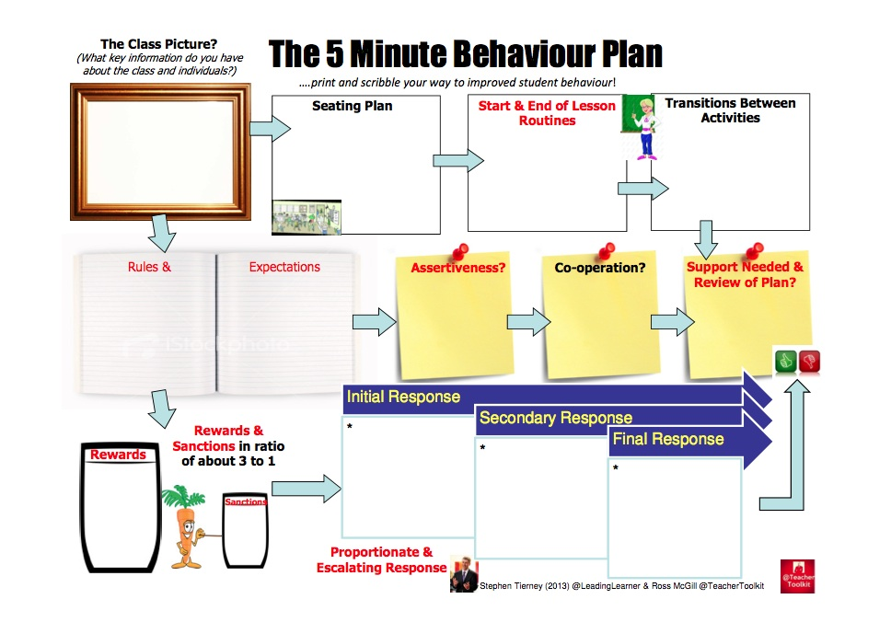
Prompts – the 5 min behaviour plan
Downloaded from http://leadinglearner.me/2013/08/23/the-5minbehaviourplan-by-leadinglearner-teachertoolkit/

Slide 15
Get ready…. in preparation for session on RJA1
Is there a particular type of behaviour that you wish to address that is occurring in a number of your classes?
Or do you have a particular class where you would like to improve your management of the students’ behaviour?
Or is there may be a key student who you would like to support in improving his/her behaviour?

Slide 16
Session 2 Theories of learning

Slide 17
Session 2 objectives
recap key learning theories and identify them in your own teaching (lesson plans)
introduce requirements of Written Assignment 2 (SWA2)
Link with teacher standard S2 – demonstrate knowledge and understanding of how pupils learn and how this impacts on learning

Slide 18
Every teacher operates within a certain theory of learning, within a philosophical context (Moore, 2000)
Thinking about theory will influence the approach to teaching and learning planned by the teacher

Slide 19
Theories of learning
Broadly speaking in two camps (MacGilchrist et al, 1997):
‘traditional’ – pupils as recipients of knowledge, passive learners
‘progressive’ – learners actively making sense of information
Although it’s never quite as simple as this
Notes:
Every teacher operates within a certain theory of learning, within a philosophical context (Moore, 2000)– so important to think about what theory when using technology, as this will influence the activity, the technology/ software and the teaching that is designed to support it.

Slide 20
Activity
Building on prior learning : what do you know already?
Behaviourist
Constructivist
Constructionist
Cognitive science
…..more?

Slide 21
Behaviourist perspectives

Slide 22
Behaviourist perspectives
Focus on the link between environment and observable behaviour
Based on notion of stimulus and response
Experimental behaviourism (Skinner)
Reinforcement
positive
negative
Law of effect
Notes:
Skinner
Pavlov
Thorndike
Law of reinforcement
* Reinforcement
The process in which a behavior is strengthened, and thus, more likely to happen again.
o Positive Reinforcement
Making a behavior stronger by following the behavior with a pleasant stimulus.
o Negative Reinforcement
Making a behavior stronger by taking away a negative stimulus.
Can be learned through trial and error
The law of effect: states that responses that are closely followed by satisfying consequences become associated with the situation, and are more likely to recur when the situation is subsequently encountered. If the responses are followed by aversive consequences, associations to the situation become weaker.

Slide 23
In the classroom
Often applied to behaviour management – positive reinforcement
Other learning : question as stimulus; student gives answer (response); immediate feedback given
Reinforcers – verbal praise, rewards (name on board, school point), prizes, good grades

Slide 24
Constructivist learning theories

Slide 25
Experiential learning: John Dewey 1859-1952
Experiential : do something, experiment, try things out, active learning.
See what happens.
Reflect on the connection between them
Importance of reflection to construct meaning
>> thinking as a distinct experience in itself
(cf behaviourist ‘trial & error’ approach)

Slide 26
Cognitive constructivism Piaget 1896-1980
Active construction and reconstruction of knowledge through experience
Cognitive development takes place through physical experiences with environment
constructing mental maps, schemas, networked concepts
Identified a series of stages for cognitive development
Notes:
e.g. Concrete stage During this stage, the thought process becomes more rational, mature and 'adult like', or more 'operational’
e.g. Formal operations stage in the formal operational stage of adolescence, the structures of development become the abstract, logically organized system of adult intelligence. When faced with a complex problem, the adolescent speculates about all possible solutions before trying them out in the real world.
Piaget comes at it through a psychological POV. Learning is about constructing a model of how the world around you works, not just about learning facts, constructing ‘a mental schema’.
Criticism of Piaget – that they work in fixed stages of development. We don’t think of children working step by step in the same way Piaget did.
Upper primary need for concrete operational – moving things, building things, direct physical objects, using , eg block, concrete physical objects for building up those mental models. Perhaps today that distinction between real world and on-screen world is not as stark as it once was. Might be just as concrete operational for them to use things on screen. E.g. think of moving chunks of code in Scratch – like Lego blocks.
Children as use software build their own mental model/schema of how it works.

Slide 27
Piaget - key elements in cognitive development
Assimilation + Accommodation
= Adaptation
Processes of assimilation important for ‘learning’ but is constrained by developmental stage
Notes:
Assimilation – assimilating a new thing/ object into an established schema
Accommodation – when you accommodate an established schema to take into account new experiences that don’t fit with an old schema
Both of these = adaptation
Say your pre-existing schema for computer is a desktop computer. If you see a desktop computer and you recognize it as computer then you have assimilated that object into your schema of computer. But say you see a laptop computer. Then you have to change your schema to fit that a laptop is a computer. When your schema is changed to fit "laptop" into it, you are accommodating your schema
Active construction of knowledge, which is reconstructed through experience

Slide 28
Socio-cultural constructivism
Vygotsky 1896-1934
Emphasis on activity (as Piaget) – but underlying assumptions are different
Learning is socially and culturally situated
Emphasis on role of communication
Role of language in development
Social interaction in mediating learning

Slide 29
Key elements
Development is shaped by culture
Zone of proximal development
Role of language
External to internalisation
Notes:
Culture contributes to intellectual development by:
Providing a knowledge base for people’s thinking
Providing or shaping the processes or means of people’s thinking – tools for thinking
Culture shapes what to think and how to think

Slide 30
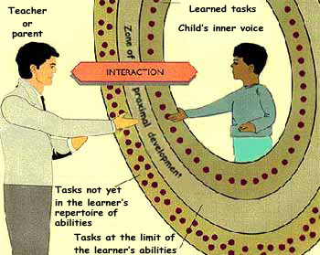
ZPD
Zone of proximal development
Potential development:
tasks at the limit of learner’s abilities - but learner can complete with guidance & support
ZPD
Learned tasks – learner can do these unaided
Social interaction is central
Tasks currently beyond the learner’s abilities
Notes:
level of actual development – potential development
what a child can do on their own – what they are capable of with help.
Social interaction is central
Language is primary mediator

Slide 31
Implications for teaching & learning
Co-operative achievement is central to learning
Scaffolding (Wood, Bruner and Ross, 1976)
Collaborative learning
Role of adult/ peer
Role of computer (tutoring systems, feedback)
Notes:
A prominent concept which has emerged from Vygotskian theory in educational contexts is that of ‘scaffolding.
Bruner's metaphorical term 'scaffolding' has come to be used for interactional support, often in the form of adult-child dialogue that is structured by the adult to maximise the growth of the child’s intrapsychological functioning (Clay and Cazden, 1990). Scaffolding refers to the gradual withdrawal of adult control and support as a function of children’s increasing mastery of a given task.
Further reading:
Wood, Bruner and Ross (1976) The role of tutoring in problem solving. Journal of Child Psychology and Child Psychiatry, 17, 89-100.
Palincsar, A. (1986) The Role of Dialogue in Providing Scaffolded Instruction Educational Psychologist, 21(1& 2), 73-98
Carlson, T. (2008) Scaffolding Instruction in a University-level GIS Course Journal of Planning Education and Research; 28; 258

Slide 32
Planning for ZPD
NOTE
Support
quantity
appropriateness
availability.
Can technology help?
Need to know learner’s strengths, weaknesses, preferences.
Differentiation.
A
Level
of support
C
B
Level of challenge
Notes:
A Easy stuff taught with too much help so no real gain & may become bored
B Hard stuff taught with almost no help leaves them annoyed, frustrated and/or baffled
C Zone of proximal development - the right level of support for the right level of difficulty… so pupils make progress

Slide 33
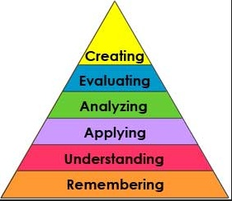
Knowledge taxonomies
e.g. Bloom’s (1956) taxonomy of the cognitive domain (revised by Anderson/Krathwohl, 2001)
Knowledge taxonomies
Does the unit allow for progression up a ‘ladder of learning’?
What are the implications for:
How you teach?
How you structure activities?
How you plan for progression?

Slide 34

Constructionism
Seymour Papert (1928 - )
http://www.papert.org/
Notes:
See handout.

Slide 35
Constructionism
Builds on constructivist theories, but also involves the creating or making of something
Achieved through the construction of a meaningful product as part of the learning activity (authentic situation)
Emphasis on the process of production and creativity in learning activity
Focus on learners’ conversation with an artifact or tool as a thing to think with (reflective)
Notes:
Theory evolved through work with digital technologies – most well known for his work with Logo
Achieved through the construction of a meaningful product – as part of the learning activity
Emphasis on the process of production and creativity in learning activity
Papert, S. & Harel, I. (1991) Situating constructionism, in: I. Harel & S. Papert (Eds) Constructionism: Research reports and essays, 1985-1990. Norwood, N.J., Ablex Pub. Corp).

Slide 36
Papert on constructionism
Constructionism - the N word as opposed to the V word - shares contructivism’s view of learning as “building knowledge structures” through progressive internalization of actions...
…...It then adds the idea that this happens especially felicitously in a context where the learner is consciously engaged in constructing a public entity, whether it’s a sand castle on the beach or a theory of the universe.
Papert, 1991

Slide 37
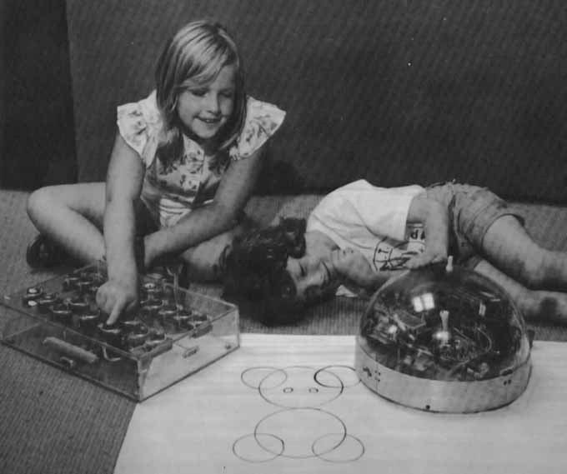
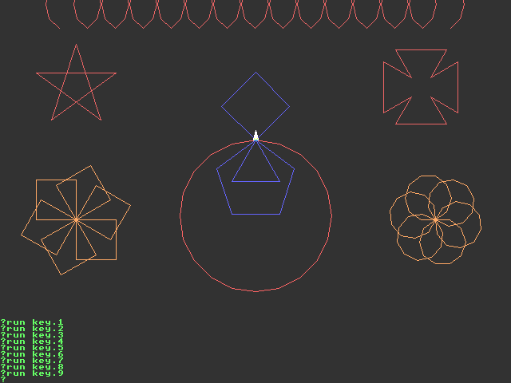
Logo
From "The Children's Machine," Seymour Papert, HarperCollins, 1993

Slide 38
Digital manipulatives – http://www.youtube.com/watch?v=e1_4IyIFQXQ
Scratch - http://www.youtube.com/watch?v=knFykmLljos
Notes:
Edith Ackermann (2001) Piaget’s Constructivism, Papert’s Constructionism: What’s the difference? http://learning.media.mit.edu/content/publications/EA.Piaget%20_%20Papert.pdf
Mitch Resnick (video)- Sowing the Seeds for a more Creative Society
http://www.youtube.com/watch?v=nxSy8nXoQNc&feature=related

Slide 39
Cognitive Science
Cognitive science including brain research and neuroscience are increasingly informing learning theories and education

Slide 40
Cognitive information processing theory
A key component of this theory is how memory works
The theory sees memorization and making connections as crucial components of learning
Notes:
One of the first major theories of learning based on emerging knowledge of how the brain works

Slide 41
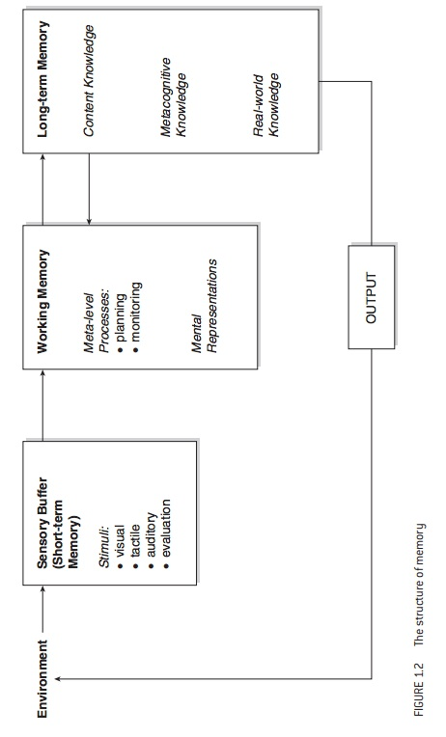
This is where we combine & manipulate information
|
Muijs, D. (2011 :31)
Notes:
Effective teaching : evidence and practice
Daniel Muijs; Los Angeles ; London : SAGE 3rd ed. C2011 Page 31 (diagram)
https://www.cheshireeast.gov.uk/children_and_families/special_educational_needs/educational_psychology_service.aspx
Sensory memory store ␣ actively stores incoming information from sensory organs. The information lasts approximately 1-4 seconds before evaporating. Only a fraction will be directed into the short-term memory.
␣ Short-term memory ␣ information is stored on a temporary basis. Up to 7 pieces of information at a time can be stored for approximately 20 seconds. By implementing specific memory strategies, the STM can be manipulated and its performance enhanced. STM is very fragile and the information evaporates if the person is distracted.
␣ Long-term memory ␣ vast store that holds learnt knowledge and past life experiences. It is estimated that only 1% of the information that passes through our consciousness will make it in the LTM. Once information is in the LTM it can be retained for lifetime, although pieces of information will decay over time with lack of use.
What is working memory?
The working memory is a short term memory store that acts as a mental workspace/jotting pad to record important information. It represents the ability we have to hold and manipulate information in the mind over a short period of time ␣ seconds, or minutes at most.
As with the STM, the working memory will fail when capacity is exceeded, when you are distracted or attention is diverted. Once the information has been lost, no amount of effort will retrieve it. If the limit is exceeded, you will forget at least some of the information. The more meaningful the information is, the more that ␣␣␣␣␣␣␣␣␣␣␣␣␣␣␣␣␣␣␣␣␣␣␣␣␣␣␣␣␣␣␣␣␣␣␣␣␣␣␣␣␣␣␣␣␣␣␣␣␣␣␣␣␣␣␣␣␣␣␣␣␣␣␣␣␣␣␣␣␣␣␣␣␣␣.
Working memory capacity is typically measured using forward/backward recall of sequences of numbers. On average, the forward digit span for an adult is 7 items, and 4/5 items for the backward digit span. Forward digit span is a measure of verbal STM, whereas backward digit span requires information to be stored and manipulated and is therefore a measure of working memory.
General characteristics of children with poor working memory
␣ More reserved in larger group activities, e.g. carpet time discussions ␣ Poor academic progress, e.g. slow to master phonic patterns ␣ Often described as making careless errors, and poor at organising work ␣ Failure to follow instructions ␣ Problems with activities that combine storage and processing e.g.
identifying two rhyming words in a text of 4 lines read by the teacher. ␣ Place keeping difficulties ␣ Attention problems ␣ easily distracted and difficulties concentrating

Slide 42
“Memory is the residue of thought” (Willingham, 2009 :54)
things can’t get into long term memory without first having been in working memory
ie you have to process and pay attention to something in order to learn it
Practice reduces the amount of ‘room’ that mental work requires in working memory (which has limited space)
Notes:
Working Memory Intervention
1. Recognise working memory failures ␣ a simple solution is to decrease workload
2. Monitor the child during mentally demanding activities - re-supply information by repeating it, directing child to memory aids or teaching memory supporting strategies
3. Evaluate the working memory demands of learning activities. Factors that influence working memory include:
␣ Excessive length ␣ Context that is unfamiliar and not meaningful ␣ A demanding mental processing activity
4. Reduce working memory loads - either during lesson planning or as learning takes place if working memory failures are present. Repeating a task can also be beneficial in helping a child to become familiar with the mental and physical demands
5. Repetition of information - encourage the child to request repetition, or pair them with a pupil who has good memory abilities
6. Encourage use of memory aids - few children will make spontaneous use of these. Physical proximity to an aid is important, make the aid available and close. Familiarising the child with the memory aids will promote ease of use.
Examples of memory aids:
␣ Writing aids - spelling aids, such as wall charts, flash cards, word strips, word blocks, personalised dictionaries
␣ Mathematical aids - such as cubes, beads, counters, abaci, number lines, fingers, multiplication grids, calculators, memory cards.
␣ Audio devices ␣ could be valuable for backing up verbal information
7. Develop the child’s use of strategies for supporting memory This promotes independent learning skills but requires training and practice:
␣ Requesting help - thus an opportunity to recover working memory failures ␣ Rehearsal - this requires full attention, and therefore is most useful when
the task involves storage only. A child will not begin to rehearse
spontaneously until they are 7/8 years old. ␣ Note-taking - jot down important information ␣
Use of Long Term Memory - encourage the child to remember material in
terms of meaningful chunks e.g. use of acronyms ␣ Place keeping/organisational strategies ␣ encourage the child to break the
task into parts, treating each part as a separate task

Slide 43
Implications
Avoid cognitive overload
working memory can be ‘overloaded’
use of ‘chunking’
Build long term memory
practising
‘mastery’
‘automaticity’
memory aids e.g. mnemonics like acronyms
Notes:
Automaticity – when the process becomes so well embedded in pupils’ long term memory that they no longer require conscious attention e.g. handwriting or touch typing/keyboarding.
This then frees space in STM for the execution of more complex tasks (Woolfolk, 1997 in Muijs 2011:46)
See also ‘unitization’

Slide 44
Storage & retrieval strength
Storage strength and retrieval strength explain why we remember some things better than others.
See the work of Bjork http://bjorklab.psych.ucla.edu/research.html
Storage strength | how well learned (or memorised?) something is
Retrieval strength | how accessible it is
Notes:
Robert Bjork, Professor of Psychol, Uni California

Slide 45
Bjork on memory
Storage strength /retrieval strength | Low storage strength | High storage strength
High retrieval strength | Exams Crammed | Your phone number Mastered
Low retrieval strength | Credit card number Unlearned | The face of an old school friend Buried
See http://bjorklab.psych.ucla.edu/research.html
Notes:
http://bjorklab.psych.ucla.edu/research.html

Slide 46
Applying theory to our work

Slide 47
“An effective teacher is one who can integrate theory with practice, use evidence to underpin their professional judgement and one who can use structured reflection to improve practice.”
Capel, Leask and Turner, 2009

Slide 48
The role of theorising
‘We recognise that talking about theory or theory building can seem slightly daunting to some researchers……
We can think about theory in terms of having and using ideas, and this seems far less daunting. Everyone can use, develop, and generate ideas……
Dey (1993, p.51) describes theory “simply as an idea about how other ideas can be related.”…
(Coffey and Atkinson, 1996:140)
Notes:
Coffey, A. & Atkinson, P. (1996). Making Sense of Qualitative Data. USA: Sage Publications Inc.

Slide 49
Theorising activity
Identify the theory you have used in the 2 lesson plans you have brought with you.

Slide 50
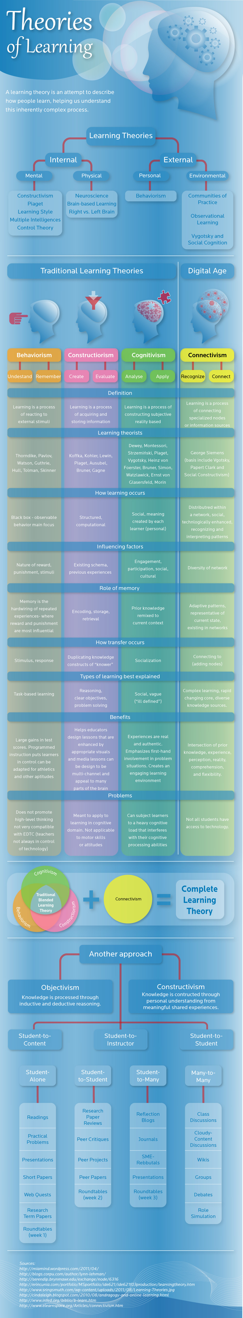
Theories of learning infographic
http://alfredovela.files.wordpress.com/2012/08/estilosdeaprendizajeyteorias.jpg

Slide 51
Useful reading
Moore, A. (2012) ‘Theories of teaching learning’ in Teaching and learning: pedagogy, curriculum and culture, pp.1-30, London: Routledge. (see Googlesite for chapter 1)
Papert, S. Mindstorms (see Googlesite for an excerpt only)
Donald Clark blog on Learning Theorists http://donaldclarkplanb.blogspot.co.uk/

Slide 52
Session 3

Slide 53
Session objectives
To engage critically with current research into the teaching of computing
Activity – research papers

Slide 54
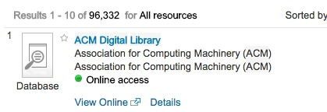
Getting started - useful resources
ACM digital library
Via library search & UCL single sign-on
Current researchers to search for : Mark Guzdial; Sue Sentance; Andrew Csizmadia; Mordechai Ben-Ari; Judith Gal-Ezer; Raymond Lister; Paul Curzon
Journals such as Computer Science education

Slide 55
CAS literature review
A classification of research into computer science education in school from 2005-2014: Initial report Sentance, S., Selby, C. (2015) (Available from CAS website)
Publications included in review:
Computer Science Education
ICER – International workshop on Computing education research
ISSEP – Informatics in school: situation, evolution and perspectives
ITiCSE – Conference on Innovation and technology in computer science education
SIGCSE technical symposium on computer science education
TOCE – ACM transactions on computing education
WiPSCE – workshop on primary and secondary computing education

Slide 56
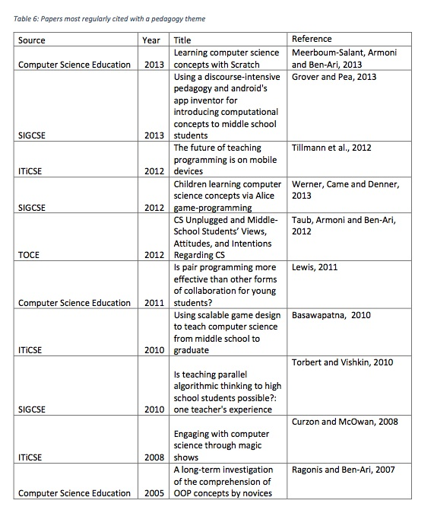

Slide 57

A really useful search engine.
You will need to refine down the results to the most relevant.
Remember also to look at citations and links to other papers.

Slide 58
Reference management software
e.g. Zotero (free) or Mendeley or EndNote

Slide 59
Research literature activity
Read your allocated paper and complete the Googledoc
Remember to keep a critical stance when reading the papers
In you summary include:
What the paper is about
Any theory referenced in the paper
What it says about pedagogy
Any misconceptions or difficulties mentioned
The findings
Any limitations of this paper
Does it make recommendations?
Anything else?
How useful was it (1 = not at all; 5 = extremely useful)

Slide 60
Session 4

Slide 61
Session 4 outcomes
Participants understand the assessment requirements of SWA2
Participants feel confident in approaching planning for WA2

Slide 62
Practitioner enquiry and tacit knowledge
Engaging in research enables teachers to link their own learning with student learning. Through this they develop their own and others’ capacity as leaders of change
Teacher research, leadership and continuing professional development should not be thought of as distinct activities - it is the task of the teacher to interpret and synthesise a range of information in order to determine what is worthwhile in contributing to their professional knowledge and how they might use it to change practice
(Durrant and Holden, 2006)
Notes:
This is what the written assignments are about – make the link

Slide 63
Written Assignment 2 (WA2)
‘Identify and analyse a significant conceptual barrier pupils face to learning a particular concept or skill in Computing/ICT. Apply ideas explored in relevant educational research on teaching and learning to devise, teach and evaluate a research-informed approach or sequence of learning which addresses this misconception or barrier.’
P30 of London Programme Guide
Deadline: Monday 9 January 2016
Word count: 5000 words +/- 10%

Slide 64
Written Assignment 2 (WA2)
‘Identify and analyse a significant conceptual barrier pupils face to learning a particular concept or skill in Computing/ICT. Apply ideas explored in relevant educational research on teaching and learning to devise, teach and evaluate a research-informed approach or sequence of learning which addresses this misconception or barrier.’
Discuss with your subject mentor something that you will be teaching next half term that is a barrier
Refer to evidence that this is a challenge (literature, your own students’ work).

Slide 65
Written Assignment 2 (WA2)
‘Identify and analyse a significant conceptual barrier pupils face to learning a particular concept or skill in Computing/ICT. Apply ideas explored in relevant educational research on teaching and learning to devise, teach and evaluate a research-informed approach or sequence of learning which addresses this misconception or barrier.’
Engage with theory around pedagogy and learning
Core theory plus links to others as relevant
Brief literature review – strengths, limitations of theory and rationale for choice.

Slide 66
Written Assignment 2 (WA2)
‘Identify and analyse a significant conceptual barrier pupils face to learning a particular concept or skill in Computing/ICT. Apply ideas explored in relevant educational research on teaching and learning to devise, teach and evaluate a research-informed approach or sequence of learning which addresses this misconception or barrier.’
Coherent series of lessons over which progression in learning can be assessed and evaluated
Suggest 4-6 periods / lessons (min. 6 hours)
You need to plan these, develop resources, teach lessons
Planning of unit needs to be rooted in theory(ies) chosen.

Slide 67
Written Assignment 2 (WA2)
‘Identify and analyse a significant conceptual barrier pupils face to learning a particular concept or skill in Computing/ICT. Apply ideas explored in relevant educational research on teaching and learning to devise, teach and evaluate a research-informed approach or sequence of learning which addresses this misconception or barrier.’
This has to be planned at the outset
Where are you starting from?
Where are you trying to get to?
How will you judge progress?
What evidence will inform your judgement?

Slide 68
Activity
Close all notes
Work in pairs
Write a paragraph which summarises the SWA2 assignment
Share with a different pair
Refine your paragraph

Slide 69
What makes work M-level?
Use of subject-specific texts
Identifying links between theories and also where they differ (conflict?)
Embedding your lines of reasoning in theory – i.e. the avoidance of assertions without evidence
Linking theory to your personal experience and professional practice
Taking a critical stance
Letting your ‘voice’ show – developing a line of reasoning
See London Programme Guide for M level marking criteria

Slide 70
WA2 – initial planning
Choose the conceptual barrier that you will investigate
Collect and annotate some evidence that supports your choice
Select a theoretical approach to your assignment
Conduct a literature review into this theory
Be ready to present your work-in-progress at SDD2 (10th November) for peer review
2 page handout – barrier, rationale, evidence, list of sources, potted literature review
Bring 4 copies to SDD2

Slide 71
WA2 – questions / ideas?

Slide 72
And finally – admin and surgery
Upcoming visits
‘Managing the workload sheet’
Please fill in your feedback form
Keep your part
Hand in my part
Please sign the register

Slide 73
Preparation for RJA1
With Brian Chick

Slide 75


For general ‘meta-analyses’ of research
Education Endowment Foundation “Teaching and Learning toolkit”
Hattie, J., Yates, G. (2013) ‘Visible learning and the science of how we learn'.
Warning – there are issues with meta-analyses – look into these and keep a critical view
Notes:
EEF toolkit https://educationendowmentfoundation.org.uk/toolkit/

Slide 76
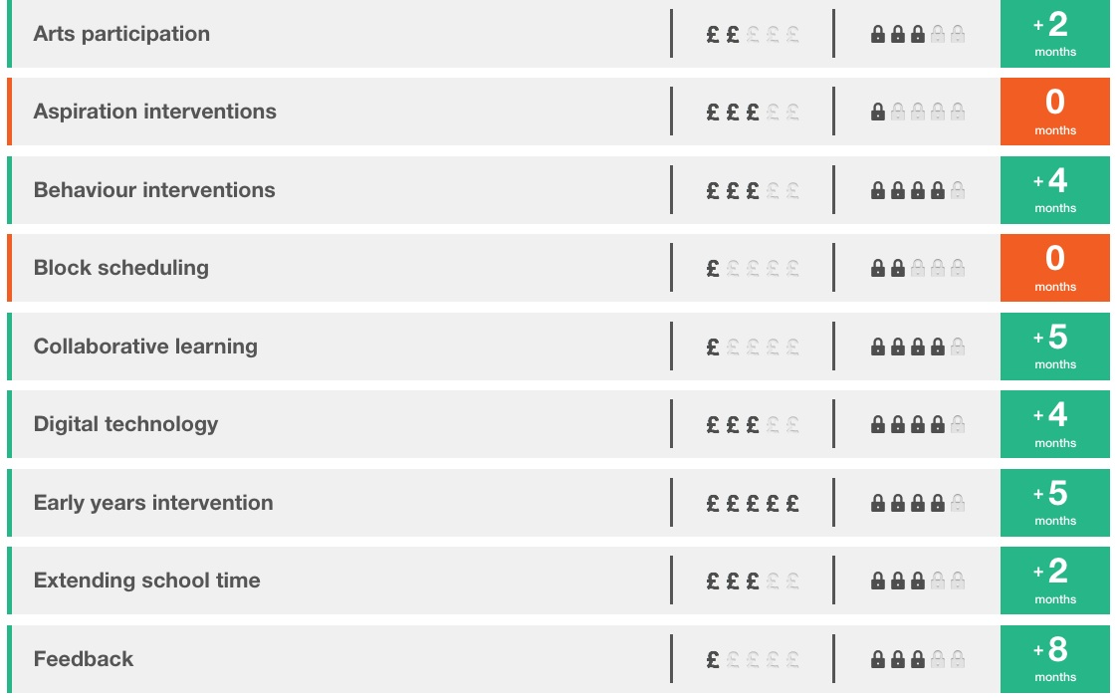
Cost, evidence, impact
Notes:
Feedback and metacognition come top

Slide 77
John Hattie book
‘Visible learning and the science of how we learn'.
September 2013
http://www.routledge.com/books/details/9780415704991/

Slide 78
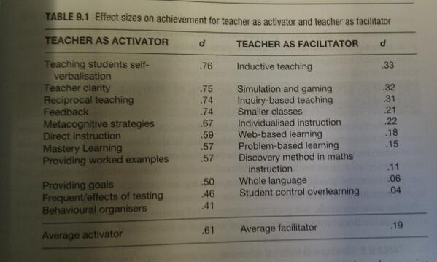

Slide 79
Constructive & collaborative approaches - programming
Code walkthroughs – reading & predicting the output (in groups giving responsibility for different parts of the code to different students)
Writing code to solve problems ``write pseudo code to simulate 500 coin tosses and print the number of heads.'’ – or set for pre-work and then groups compare code in class & come up with a group solution, handing in individual & group solutions
Scaffolding
e.g. giving code to pairs which they build upon e.g. adding comments to describe what the code does
or giving comments which describe an algorithm for students to write the code.
Code debugging – give groups syntactically and logically buggy code (or complete individually and then compare in groups)
Based on Van Gorp, M.J. & Grissom, S., (2001)
Notes:
Van Gorp, M.J. & Grissom, S., 2001. An Empirical Evaluation of Using Constructive Classroom Activities to Teach Introductory Programming. Computer Science Education, 11(3), pp.247–260.

